Slide 1
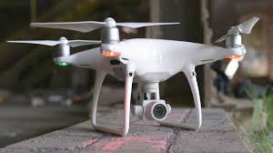
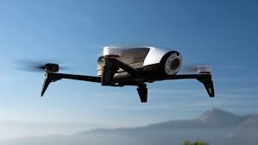
Project Activity Overview
Drone Project: Security Analysis- attacks and Countermeasures
By
Vishal Dey

Slide 2
Motivation
Spying and monitoring
Photography
Defence
Handling situations like firefighting, human rescue and adverse terrain
Delivering goods by Amazon and Domino’s
Security threats

Slide 3
DJI Phantom 4 Pro
Vulnerabilities
  Vulnerabilities in DJI SDK: crack the DJI SDK, remove authentication between server and DJI app by decompiling and patching code
  Reverse Engineering firmware
  GPS Spoofing over DJI Phantom 4 Pro using LabSat
  Control and Video transmitted using RF, thus can be scanned and manipulated using SDR equipments like HackRF obscuring live feed

Slide 4
DJI Phantom 4 Pro
Countermeasures
  Use encryption/packer to protect library files.
  Use obfuscator to prevent decompiling, reverse-engineering files
  SDK authentication, now being done only between the app and server, drone must also be included in the one-time authentication.
  Anti-spoofing and anti-jamming
  Detect fake GPS signals using latency, bit delays, checking GPS subframe data
  Encrypt the entire firmware binary, the encryption key must be stored in the hardware, some of the binaries in P4 pro are encrypted and signed

Slide 5
Parrot Bebop 2
Vulnerabilities
  Open WiFi: multiple connections, vulnerable to all WiFi attacks, deauthenticate the owner
  Open FTP access: root access to entire FS is possible changing some config files
  Open telnet with root access: crash-land the drone killing the main process: ‘dragon-prog’
    telnet 192.168.42.1
    kill -9 $(ps -e | grep ‘dragon-prog’)
  MAC Spoofing

Slide 6
Parrot Bebop 2
Countermeasures
  Adding WPA security to the WiFi
  Hidden SSID so that it does not appear in the available networks
    Open telnet and execute the command:
    bcmwl closed 1
  MAC address filtering
    Open telnet and execute the command:
    bcmwl mac <MA:CA:DD:ID:01> <MA:AC:DD:ID:02>
    bcmwl macmode 2
  Add Telnet password

Slide 7
Future Work
Radio Frequency Spectrum Analysis for DJI Phantom 4 Pro
Design of a video encryption module for reliable transmission
ArduPilot for Bebop 2

Slide 8
Conclusion
Harder than expected due to non-determinism of robotics and unavailability of proper hardware
DJI Phantom4 Pro is much more secure than Parrot drones as Phantom4 Pro communicates and sends video over RF which requires costly hardware to intercept whereas Parrot Bebop uses open WiFi
Drones shall remain vulnerable to GPS spoofing unless receiver also have the capability to detect spoofing like SAASM used by military- thus need for developing anti-spoofing and anti-jamming recivers

Slide 9
Q & A
Thank You

